Slide 1

Google Summer of Code
Jiří Eischmann & Carlos Soriano & Milan Ceska
Notes:
Hello everyone, we are gonna present this program called google summer of code. We are Jiri, which worked with communities for quite a long time, Milan, who was mentor for 2 years, and me, that I was student for 2 years, mentor for 1 year, and then mentor and admin for 1 year more. So everyone of us has its own perspective of the program that we would like to share with you.

Slide 2
Overview
What is GSoC
Organisations
Outreachy - The alternative
Our personal experience
FAQ
GNOME for GSoC & Hackaton

Slide 3
What is GSoC?
Google Summer of Code (GSoC) is an online, international program that gives students the opportunity to participate in free software development during summer break
Working with a free software organisation
Working from home
Notes:
Can you name any free software organization?

Slide 4
Students - Why to participate?
Work as an Software Engineer.
Experience a complex, real world project.
Personal experienced mentor for you.
Build a resume with a well known organisation.
Go to an international conference.
More than good stipend of $3600
Notes:
How many of you worked on summer? And how many as a software engineer?
How big are the projects you work on? 10000 lines as most? Do they have extensive testing frameworks? Projects are bigger than most of proprietary programs. Nautilus 170.000 lines of code. Linux kernel has 17 million.
You are probably learning here at university... what’s the ratio student per teacher? Could you imagine a person with real world experience guiding you personally? This is something that you cannot even get in most companies with regular jobs.
One of the issues to get a job when you are fresh out of university is that all of you are the same, “just” a degree with higher or lower marks. But can you imagine the difference that makes have been working on an organisation that makes projects that even those in the company are using? It will make you different than most of candidates.
Also there is a possibility to go to an international conference, it depends on the organization, but usually in the big ones is encouraged to go and they will sponsor your trip.
You get paid 3600$

Slide 5









Organisations

Slide 6
Organizations - Why to participate?
Students will push forward the project.
Opportunity to get an established contributor.
$500 for each student mentored.

Slide 7
Conditions for students
At least 18 years old.
Must be enrolled in an accredited institution like a university, PhD or undergraduate programs.
Must be eligible to work.

Slide 8
Conditions for organizations
Organizations must run an active free software project.
Have produced and released software under an OSI approved license.

Slide 9
Timeline
Feb 9 - Organization Application Deadline
Feb 27 – Organizations Announced
Mar 20 – April 3 – Student Application Period
May 30 – Aug 21 – Coding
Sept 6 – Results Announced

Slide 10
GSoC 2016
180 organizations participated.
5107 students from 142 countries sent applications.
1206 students got accepted.

Slide 11
Alternative - Outreachy
Program to attract more women into open source.
The same dates:
  Application deadlines – Mar 30.
  Working (it‘s not only about coding) – May 30 – Aug 30
The same stipend - $5500

Slide 12
Research Projects at GSoC
GSoC supports also academic tools
  open software + “strong” user base
  scientific computation, robotics, verification, AI
my experience – PRISM model checker
  verification and performance analysis of systems with random and probabilisitic behaviour
  Oxford and Birmingham University (since 2001)
  100+ publications and 60K downloads
  mentor (2014, 2016) within my postdoc at Oxford

Slide 13
PRISM at GSoC
participated in 2013, 2014 and 2016 with 2, 8 and 5 funded projects, respectively
every year PRISM offered 10+ projects and received around 50 student's applications
  from purely engineering project to research topics
  some projects led to strong publications
all projects have been successfully finished
  careful admission process
  communication-intensive mentoring with week reports and detailed mid-term evaluations

Slide 14
PRISM at GSoC – My Projects
Refactoring and optimisation of core computational kernels
  engineering project aiming at performance improvements
  3x speedup + 6x memory footprint reduction
Adding new functionality - Parameter synthesis
  design and implementation of a new method
  Dean's award for the exceptional master thesis
  led to two strong publications
  student got a position at Google

Slide 15
How To Be Successful in GSoC?
Be Proactive!
Admission process
  demonstrate your ability to grasp the key concepts
  don't hesitate to contact the mentors
  show your communication skills, technical background, and out-of-the-box thinking
Working on your project
  be sure that the mentor follows your work
  try to overcome obstacles, but don't get stuck
  communication with your mentor is essential

Slide 16
FAQ
Am I smart enough?
Is my English good enough?
Is going to be a project for me?
Should I left my current half time job?
The timeline overlaps my university, is it fine?
What mentors look for to choose an student?
Can I fail?
Is it important enough for me even if I plan to work on something else afterwards?
Notes:
Not need to be smart, just proactive. People doing the program doesn’t need to be geniuses.
Basic english is good enough, most people are not english native.
If you are proactive, the organisation and mentors will try to search for an alternative project in case the one you want to apply is full
It is fine, you will discuss with the mentor how to move that time around, most probably using some weekends time or at the end of the program.
Most important part is to be proactive, not needing handholding but search for yourself. Remember that the mentors are doing it for free.
It’s expected and normal than some students fail the program. However you can fail also only part of it, which is better than the whole program. Failing the program doesn’t mean you won’t get another oportunity next year, is perfectly fine.
Yes, it’s important because working on this program is not about the actual technology or project, but about the communication, the proactivity, your own progression, etc. A software engineer is not someone in a dark room, but rather one that communicates between teams and knows how to contribute to a large project.

Slide 17
Want to apply?
https://summerofcode.withgoogle.com/
Choose organization
Choose project
Ask mentor
Start contributing
Alternative - https://www.gnome.org/outreachy/

Slide 18
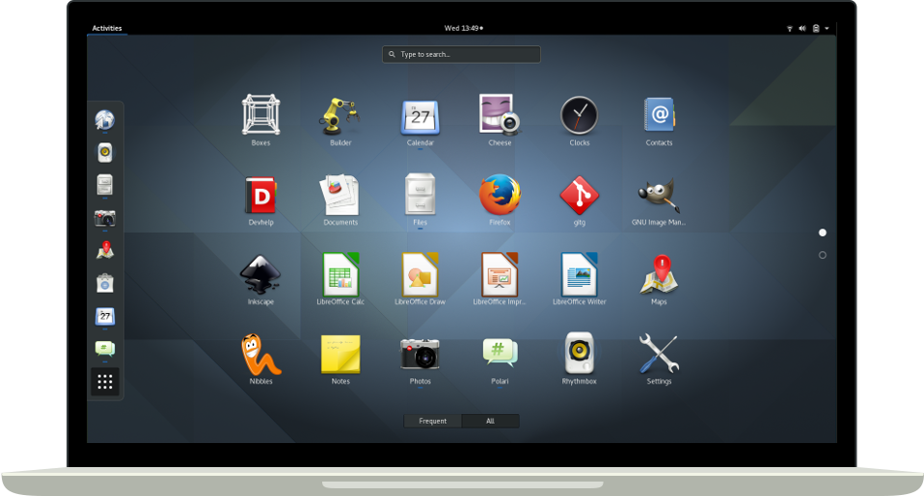
GNOME
Notes:
GNOME is a desktop environment and development platform, that means GNOME provides the whole desktop experience together with tools and technology for developing applications for that platform.

Slide 19





GNOME – Used and developed

Slide 20
GNOME
Apps – File manager, Photos, Calendar, etc.
Libraries – Gtk+, libretro (games emulator), etc.
Tools – Pitivi (video editor), GIMP, Builder (IDE)

Slide 21

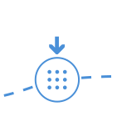
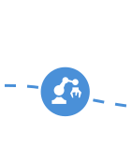
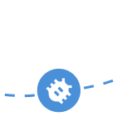

GNOME Hackaton for Students
Learn to contribute to GNOME and increase your chances for GSoC
Monday 20 15:00 - 20:00 at Red Hat Lab
Facebook event: http://tinyurl.com/j5uon99

Slide 22
Contact
Carlos Soriano - csoriano@gnome.org
Jiri Eischman - jeischman@redhat.com
Milan Ceska - ceskam@fit.vutbr.cz
Slides - Github - csoriano89

Slide 23
Thank you!

